Slide 1
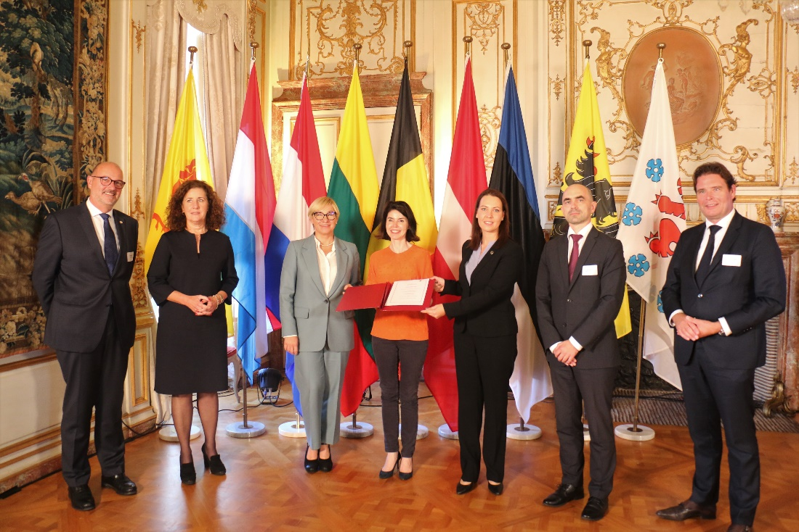
Treaty on the automatic recognition of higher education qualifications by the Baltic states & Benelux member states
Public launch of the Treaty
September 27th 2021, Brussels
Berto Bosscha
Emmy Heijmans
December 1st-2nd 2021

Slide 2
Introducing
Benelux-Baltic cooperation in higher education: Automatic recognition of qualifications - YouTube

Slide 3
Importance of automatic recognition
The need for automatic recognition of qualifications has been repeatedly emphasised
Bucharest Communiqué – 2012
Yerevan Communiqué - 2015
Paris Communiqué - 2018
In higher education, recognition procedures often remain too complicated or too expensive and too many mobile students do not obtain full recognition of successfully achieved learning outcomes.
However, several Member States have taken the initiative to make progress towards automatic mutual recognition, including through the signature of regional agreements. These initiatives could serve as models for the creation of a Union-wide system. – 2018 Council Recommendation

Slide 4
Start of the multilateral treaty
The Decision of the Benelux Committee of Ministers concerning the automatic mutual generic level recognition of higher education degrees in 2015 (bachelor’s degrees and master’s degrees).
supplemented by the decision in 2018 (associate degrees and doctoral degrees).
The Agreement among the Government of the Republic of Estonia, the Government of the Republic of Latvia and the Government of the Republic of Lithuania on the automatic academic recognition of qualifications concerning higher education in 2018.
Declaration of Intent by the Baltic States and Benelux Member States to explore the possibilities for drafting a multilateral treaty in 2019.

Slide 5
Aims of the treaty
Mutual trust in the education systems
More transparant recognition
Contribution to the EHEA

Slide 6
Automatic recognition in practice
→ A HE qualification is automatically recognised at the same level of the corresponding HE qualification (AD, BA, MA, doctoral) issued by another country.
The basis for mutual trust lies in the ratification of the LRC and active membership of the EHEA.
The treaty/AR does not apply to:
a) recognition of the specific programmes
b) recognition of periods of study
c) recognition of qualifications that do not belong to the HE system
d) recognition of professional qualifications

Slide 7
Accession to the treaty by other countries
Countries may apply to accede to the treaty by handing in an application to the depositary (the Secretariat-General of the Benelux Union)
… if the following conditions are met (article 13)
Ratification of Lisbon Recognition Convention
Member of the European Higher Education Area
Application of trustworthy quality assurance systems for HE programmes, demonstrated by proven compliance with the ESG
A three-cycle system, in compliance with the QF-EHEA
Referencing of the national HE QF to the EQF

Slide 8
More information
Link to the Treaty
Link to the Declaration of intent
Link to the Council Recommendation
For more factual information on the relevant provisions of the Treaty, please contact Mr. Stephane Verwilghen (s.verwilghen@benelux.int) of the Benelux Secretariat.

